Slide 1

DATA ANALYST PROJECT BASED ON SONGS DATASET
-Saurav Shinde

Slide 2
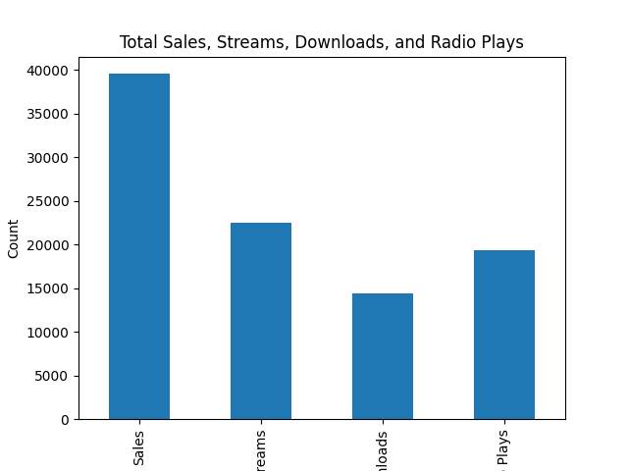
Total Sales, Streams, Downloads, Radio Plays

Slide 3
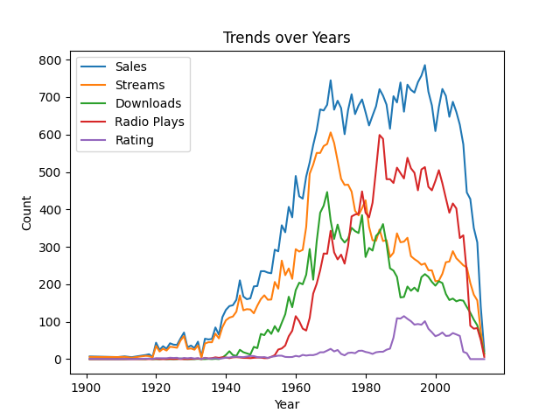
Trends over Years

Slide 4
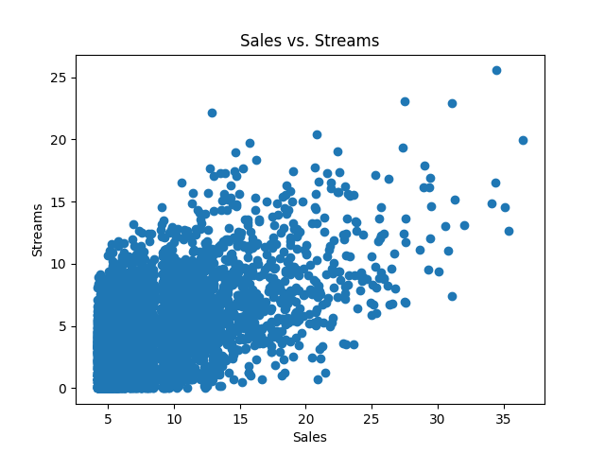
Sales vs Streams

Slide 5
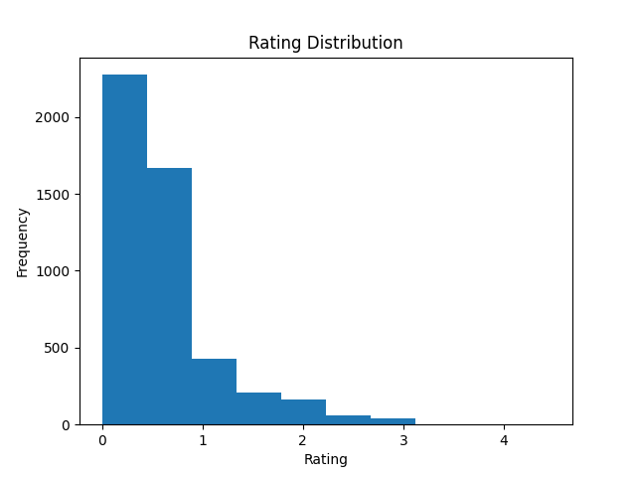
Rating Distribution

Slide 6
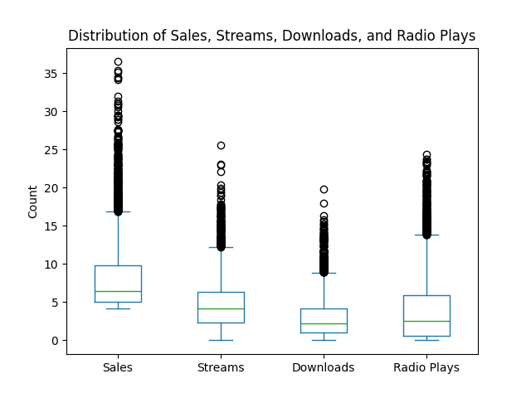
Distribution of Sales, Streams, Downloads, and Radio Plays

Slide 7
Thank you!

